Slide 1
Enhancing Comprehensive HIV Prevention Planning
A Syndemic Spatial Analysis of HIV and STI Burden
Mike Janson, MPH, Virginia Hu, MPH, Kai-Jen Cheng, Douglas Frye, MD, Peter Kerndt, MD,
Jennifer Sayles, MD, MPH
Los Angeles County Department of Public Health
2011 National HIV Prevention Conference
August 16, 2011

Slide 2

 | Los Angeles County | California
Estimated living HIV/AIDS Cases | 61,700 | 133,705*
Reported HIV/AIDS Cases | 44,450 | 110,994
Los Angeles County | California
9,848,011 | 36,961,664
Los Angeles County | California
4,060 sq mi | 155,959 sq mi
Data Source: Los Angeles County Department of Public Health, HIV Surveillance, 2011; California State Department of Public Health, State Surveillance Data, 2010
*133,705 calculated assuming 21% of HIV positive Californians are unaware of their status.
Data Source: U.S. Census , 2010
Notes:
(Optional slide): This slide shows Los Angeles County in comparison with the State of California. We are 2.6% of the state’s land area, 26.6% of the population, and 46.1% of the estimated living HIV/AIDS cases as of January 1, 2011.

Slide 3
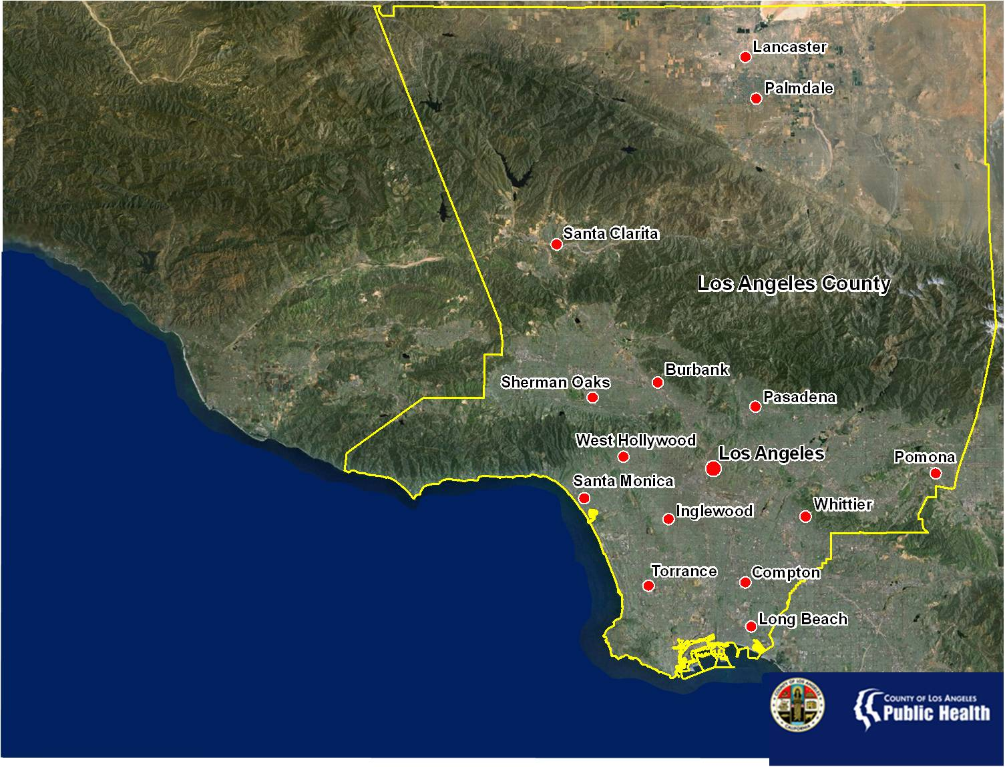
Population | Estimated HIV/AIDS Cases
9,848,011 | 61,700
Data Source: U.S. Department of Commerce, 2010; Los Angeles County Department of Public Health, HIV Surveillance, 2011
Notes:
Los Angeles County is the most populous in the United States with 9.8 million residents. The County is diverse in both it’s people and geography. There is no one majority racial/ethnic group and the County’s geography consists of urban, suburban, and rural areas divided by several mountain ranges.

Slide 4
Los Angeles County
Chicago
Houston
New York City
San Francisco
Philadelphia
Data Source: U.S. Census Bureau, Topologically Integrated Geographic Encoding and Referencing system, 2009. Maps Drawn at 1:750,000 scale.
District of Columbia
Notes:
(Optional slide): With over 4,000 square miles, Los Angeles County is larger than San Francisco (City and County), The District of Columbia, Philadelphia, Houston, Chicago, and all 5 boroughs of New York City combined.

Slide 5
LAC ECHPP Activities
Syndemic Planning
  Integrated use of HIV and STI surveillance data
Identify optimal mix of HIV programming
  Robust Decision Making to inform prioritization, scale, and optimal mix of HIV prevention interventions for LAC
Where should we focus our prevention efforts to make the largest impact with resources we have?
Notes:
The integration of programs is intended to reduce duplication of services, maximize all available resources, and see clients holistically rather than through the disparate lenses of disease prevention and treatment. Integration activities are expected to become finalized within the next 18 months.

Slide 6
Syndemic Planning Model
Focuses on connections among cofactors of disease
  HIV
  Syphilis
  Gonorrhea
Considers those connections when developing health policies
Notes:
Two or more afflictions, interacting synergistically, contributing to excess burden of disease in a population
Linked epidemics, interacting epidemics, connected epidemics, co-occurring epidemics, co-morbidities, and clusters of health-related crises

Slide 7
Service Planning Areas (SPAs)

Slide 8
HIV Case Density, 2009, SPA 8
Very Low Density
Very High Density
Source: 2009 New HIV Cases, HIV Epidemiology Program

Slide 9
Spatial Analysis Background
Services historically prioritized by Service Planning Area (SPA)
  Disease burden geographical differences are not explained by SPA boundaries
  The use of GIS allows for small-area analysis and spatial epidemiological techniques
  The sharing of HIV and STI surveillance data have allowed for a more accurate picture of overall the overall HIV/STI syndemic

Slide 10
Data Sources
New HIV/STD Cases, 2009
  2,036 HIV cases
  2,641 Syphilis cases
    1,042 with HIV co-infection
  7,918 Gonorrhea cases
    552 with HIV co-infection
Case residence addresses were geocoded
  Overall geocode match >92%

Slide 11
Methodology
Are HIV/STI cases dispersed or clustered?
  Average Nearest Neighbor (ANN) statistic, (ArcGIS)
Can patterns be grouped into manageable clusters?
  Nearest Neighbor Hierarchical Clustering, (CrimeStat)

Slide 12
Results
Average Nearest Neighbor Summary¹
 | Index | Z-score | P-value | Result
HIV | 0.42 | -45.9 | <.0001 | Clustered
Syphilis | 0.26 | -73.1 | <.0001 | Very Clustered
GC | 0.18 | -140.3 | <.0001 | Very Clustered
¹Average Nearest Neighbor statistic computed using fixed-distance band conceptualization.

Slide 13
Nearest Neighbor Hierarchical Clustering
Summary¹
¹Nearest Neighbor Hierarchical Clusters output at 1.0 standard deviations using fixed-distance band threshold

Slide 16
Testing Effort Analysis
What proportion of public HIV testing was done within the cluster areas?

Slide 17
Source: HIV Testing Services, 2009

Slide 18
Source: HIV Testing Services, 2009; City of Long Beach Health Department,

Slide 19
Spatial Correlates of HIV/STI
Why are new HIV/STI cases clustered in specific areas within Los Angeles County?
  Dense population areas
  Income
  Education Level

Slide 20
Getis-Ord Gi* calculated at 6,000 foot threshold using the fixed distance band
spatial conceptualization
Source: American Community Survey, 5-year estimates, U.S. Census

Slide 21
Conclusions
HIV cases are clustered within Los Angeles County; Syphilis and GC cases are very clustered
Five cluster groups represent more than 80% of all HIV/STI cases and < 33% of the land area
Poverty is correlated with 4 of 5 cluster areas
Current HIV testing resources are mostly in line with HIV/STI syndemic

Slide 22
Limitations
Spatial Model limited to new HIV/STI cases for 2009
Missing some co-infection due to unmatched surveillance data
Assumes that infection occurs within resident case clusters
Does not fully include homeless populations

Slide 23
Next Steps
Include multiple years of new cases to assess trends
Include prevalence cases
Examine relationships of upstream determinants of health with HIV/STI
  mental health, sub use, poverty, violence
Include community viral load as a factor

Slide 24
Next Steps (Cont.)
Spatial Regression
  Determine how much of each co-factor is contributing to the spatial pattern of HIV/STI cases
Notes:
How about bigger picture next step as well: examine relationships of upstream determinants of health with HIV/STI– mental health, sub use, poverty, violence
Also could include community viral load as a next step, it has to be done with surveillance data, not just RW subset to be meaningful.

Slide 25
References
Mitchell, Andy. The ESRI Guide to GIS Analysis Volume 2: Spatial Measurements & Statistics. 1st Edition. Redlands (CA): ESRI Press; 2005.
2. de Smith, Michael J; Goodchild, Michael F; Longley, Paul A. Geospatial Analysis: A Comprehensive Guide to Principles, Techniques and Software Tools. 3rd Edition. UK: Splint Spatial Literacy in Teaching; 2011

